Slide 1

A Current Look Into Aviation Safety

Slide 2

It appears as though the public believes air travel is no longer the safest means of travel…
Approach
The approach of this challenge is to explore recent accident data to explore and validate this claim from the media and public

Slide 3
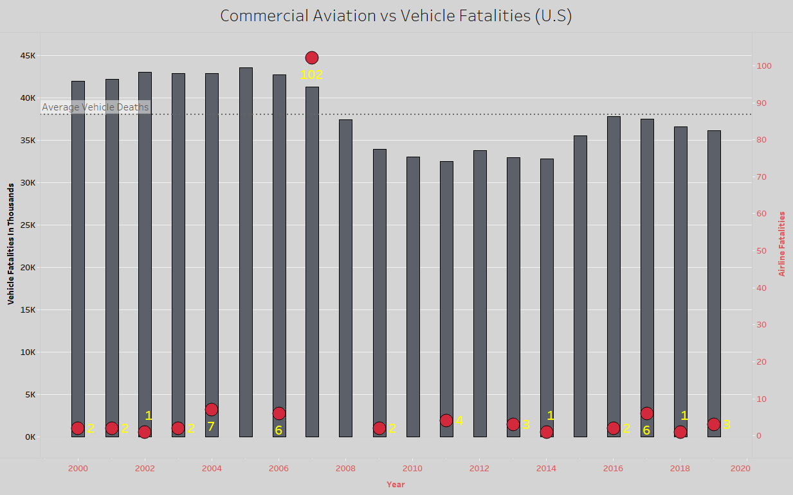
Commercial Aviation is still by far a much safer form of travel compared to road vehicles….

Slide 4
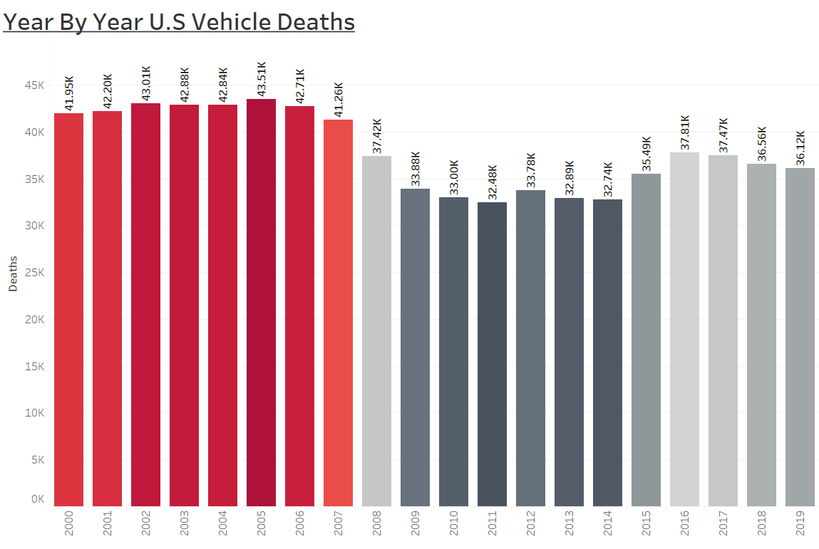

It appears that domestic road vehicle deaths are on the decline…
This decline may attribute to why the public thinks that airline travel is less safe. But the two are not related.

Slide 5
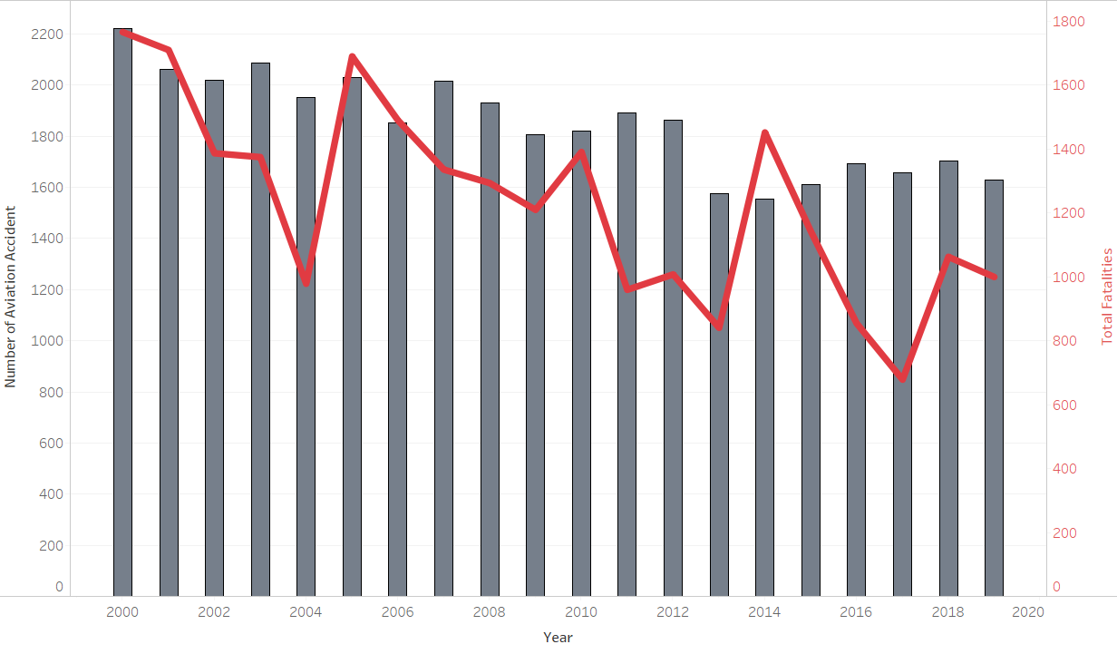
It appears that overall aviation accidents are on the decline…with one caveat…..
This visualization is representative of the high rate of personal aviation accidents.

Slide 6
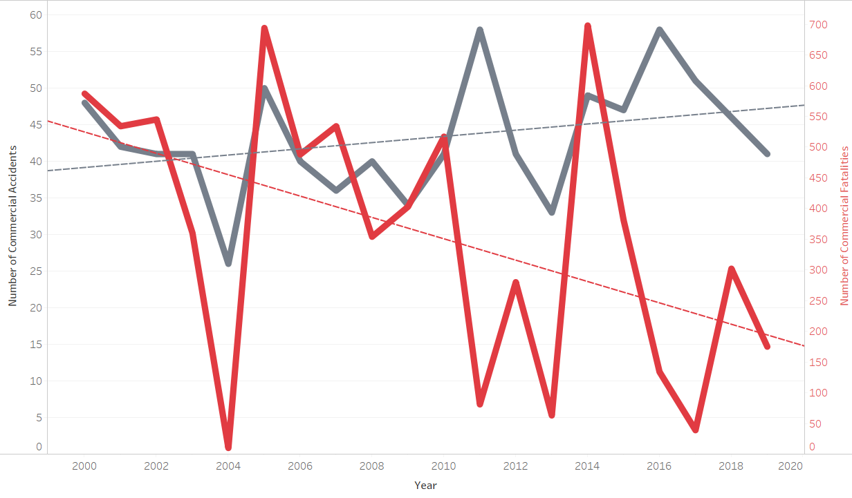
But we should take a look at commercial aviation fatal accidents….
It appears that the publics claim does hold some weight.
Commercial aviation accidents are on the rise.
But it appears that fatalities are trending down.
This visualization is also worldwide and not domestic travel.

Slide 7
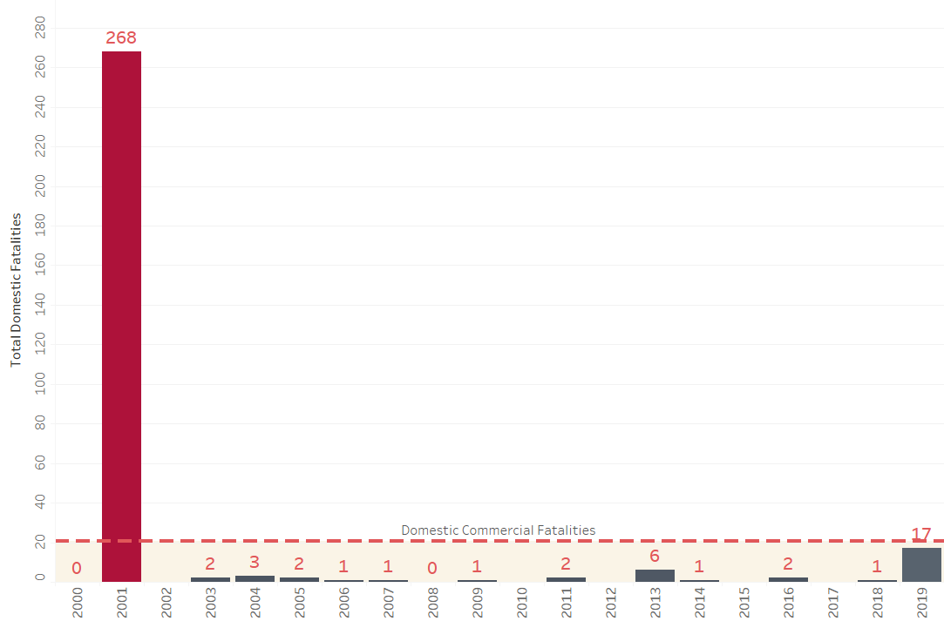
And domestic fatalities should not cause alarm…
It appears that domestic commercial airline fatalities have remained rather consistent and do not contribute to the popular “unsafe” categorization.

